Slide 1
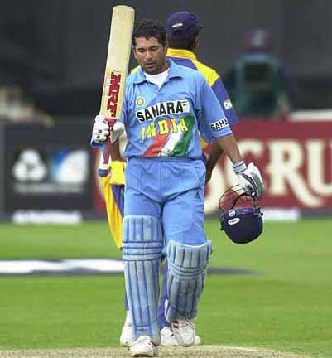
Analysing Sachin Tendulkar
Strengths
Weaknesses

Slide 2
Common Strengths
  • Positive person
  • Can sing well
  • Fast at work
  • Good family background
  • Creative
  • Can make friends easily
  • Know different languages
  • Active person
  • Good at cooking
  • Others can depend on me

Slide 3
Common Weaknesses
  • Get bored easily
  • Short tempered
  • Lazy
  • Addicted to alcohol/cigarettes/Gutkha
  • Lack confidence while speaking in public
  • Not a friendly person
  • Not good at work compared to others
  • Cannot share feeling with others

